Slide 1
SampCert: Verified Foundations for Differential Privacy
Markus de Medeiros^{1,2} Muhammad Naveed¹ Tancrède Lepoint¹
Temesghen Kahsai¹ Tristan Ravitch¹ Stefan Zetzche¹ Anjali Joshi¹ Joseph Tassarotti² Aws Albarghouthi^{1,3} Jean-Baptiste Tristan¹
¹ Amazon Web Services
² New York University
³ University of Wisconsin-Madison
Notes:
Lower your vocal register
Thank you _ for the introduction. I’m Markus, I am a PhD student at New York University and a research intern at AWS,
Today I’m going to tell you about SampCert, our project about verified differential privacy in Lean.
TODO’s:
Consistent fonts
Syntax Highlighting
Finish figures

Slide 2

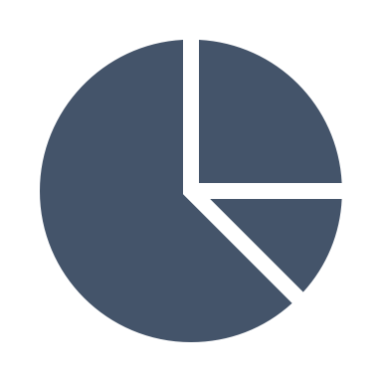





Notes:
Imagine, you’re a statistician.
You can picture that your day job amounts to
Collecting data, from public and private sources,
Organizing and computing over that data,
And finally, generating statistics and decisions based on that data which you send out to the public
Given that your sources may be private you want to ensure that your statistics don’t accidentally leak any information you didn’t mean do.
For example you might work at the US Census Bureau. On it’s own it might be OK to disclose the maximum income of a zip code, whereas it is not OK to disclose the income reported by each address
FLIP
Now in a perfect world, each statistic you release would only disclose the aggregate information about your dataset which you intended to make public

Slide 3
Notes:
Imagine, you’re a statistician.
You can picture that your day job amounts to
Collecting data, from public and private sources,
Organizing and computing over that data,
And finally, generating statistics and decisions based on that data which you send out to the public
Given that your sources may be private you want to ensure that your statistics don’t accidentally leak any information you didn’t mean do.
For example you might work at the US Census Bureau. On it’s own it might be OK to disclose the maximum income of a zip code, whereas it is not OK to disclose the income reported by each address
FLIP
Now in a perfect world, each statistic you release would only disclose the aggregate information about your dataset which you intended to make public

Slide 4

Notes:
Unfortunately, and I hope this isn’t a surprise in the security session, but the world is not perfect.
Attackers have found clever ways to learn a great deal of sensitive information using unintentional data leaks in innocuous looking statistics. Going back to my example, knowing the precise maximum income in a zip code also tell an attacker that someone with that exact income does live in that zip code, which can be enough to identify them.
By leveraging automated constraint solvers and correlations with public knowledge, attackers have managed to target and re-identify individuals in real-life datasets, even when traditional anonymization techniques are put in place.

Slide 5
$42, 321
$42, 321
Notes:
Unfortunately, and I hope this isn’t a surprise in the security session, but the world is not perfect.
Attackers have found clever ways to learn a great deal of sensitive information using unintentional data leaks in innocuous looking statistics. Going back to my example, knowing the precise maximum income in a zip code also tell an attacker that someone with that exact income does live in that zip code, which can be enough to identify them.
By leveraging automated constraint solvers and correlations with public knowledge, attackers have managed to target and re-identify individuals in real-life datasets, even when traditional anonymization techniques are put in place.

Slide 6
Constraint Solvers
Quasi-identifiers
$42, 321
$42, 321
Notes:
Unfortunately, and I hope this isn’t a surprise in the security session, but the world is not perfect.
Attackers have found clever ways to learn a great deal of sensitive information using unintentional data leaks in innocuous looking statistics. Going back to my example, knowing the precise maximum income in a zip code also tell an attacker that someone with that exact income does live in that zip code, which can be enough to identify them.
By leveraging automated constraint solvers and correlations with public knowledge, attackers have managed to target and re-identify individuals in real-life datasets, even when traditional anonymization techniques are put in place.

Slide 7
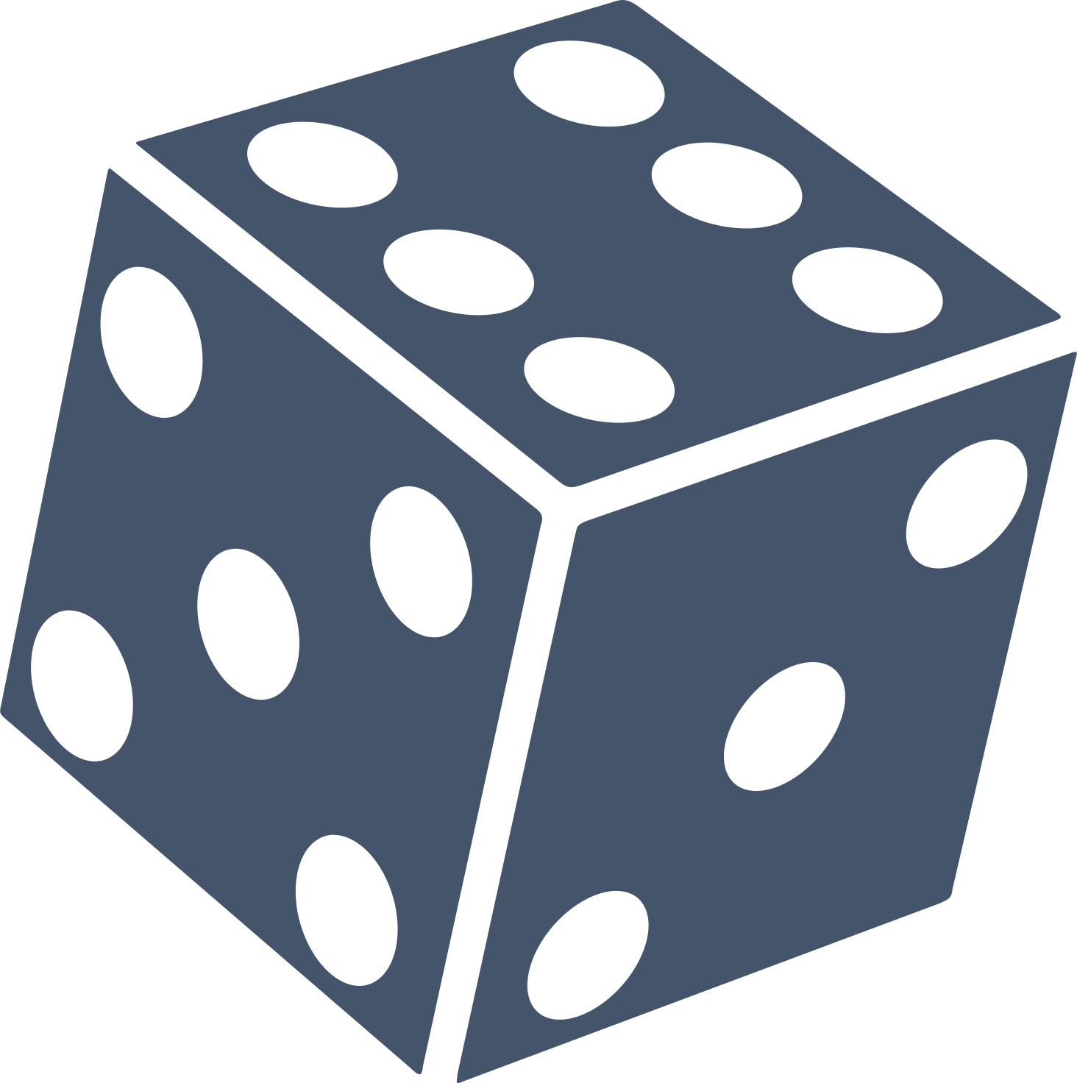
Differential Privacy
Notes:
So what can we do about this?
Privacy researchers have defined a notion called differential privacy,
which establishes a bound on the amount of information an attacker can learn about your dataset from any given statistic.
While these re-identification attacks are remarkably effective, it turns out that they are also very brittle.
The theory of differential privacy says that if you add the right amount, and right kind of random noise to your output, you can ensure that even very strong attackers
will be able to learn very little about your true dataset.
So, that’s great! Problem solved right?

Slide 8
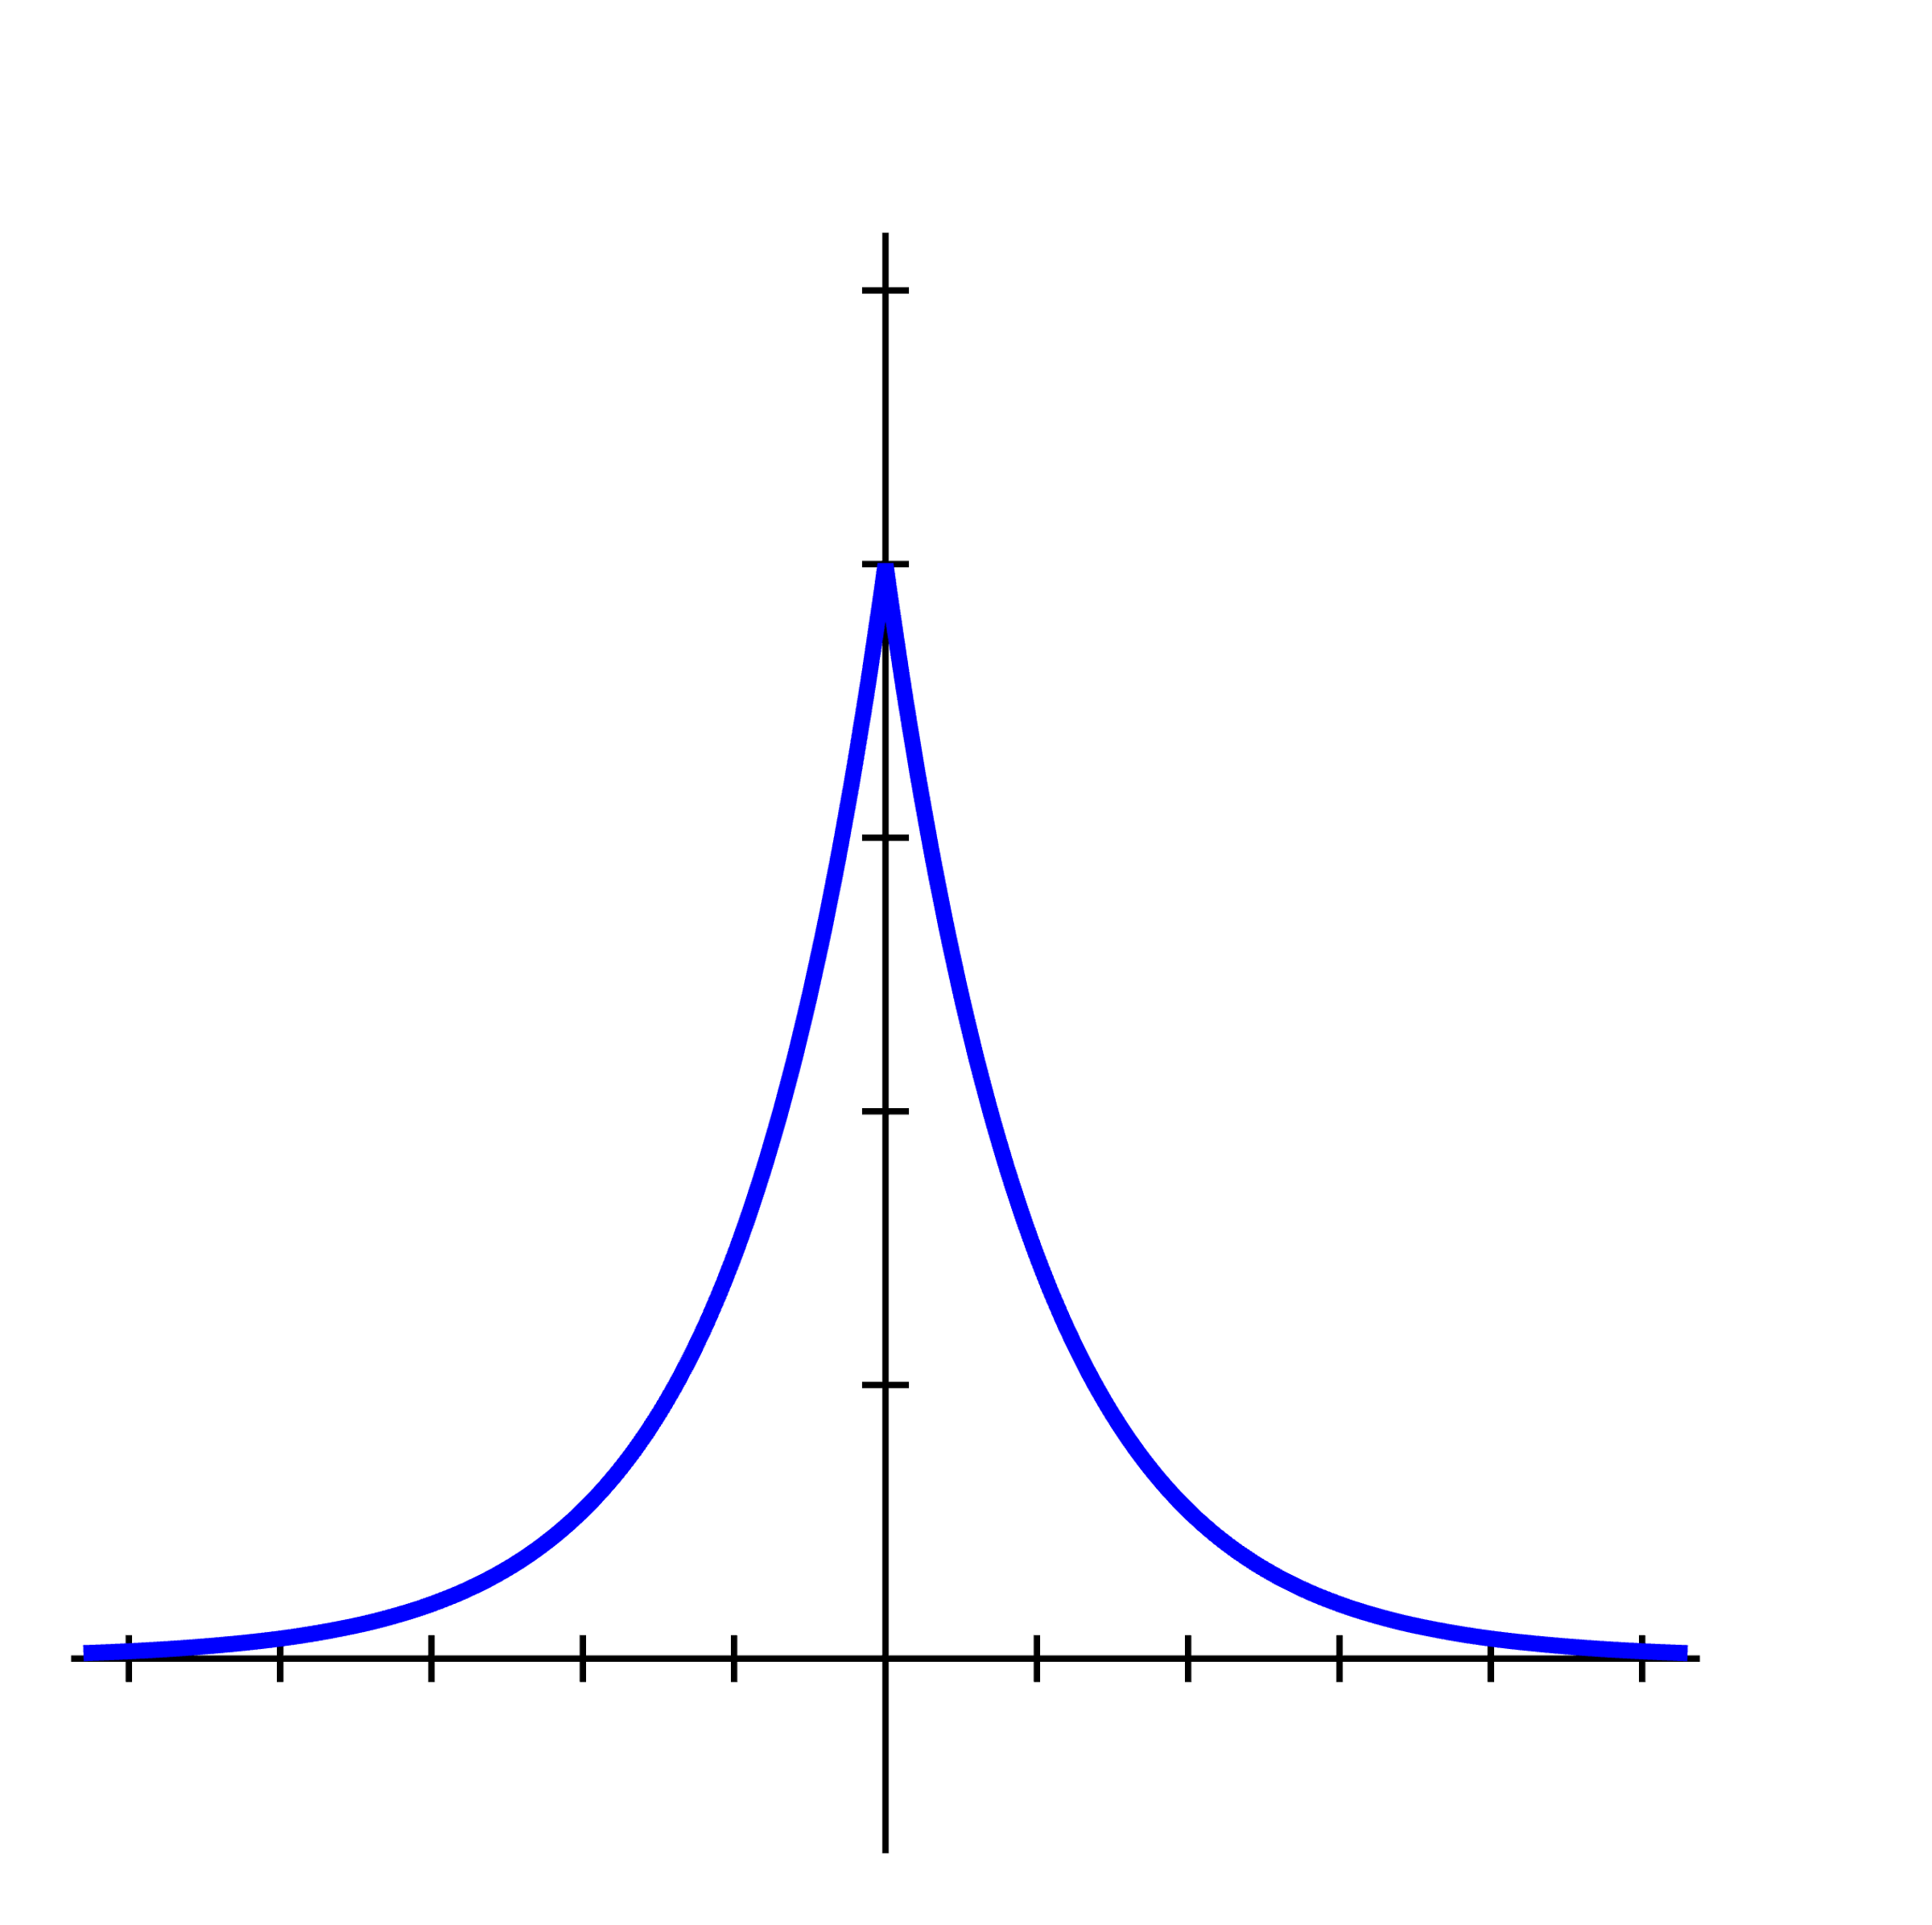
Differential Privacy?
Notes:
Sadly, no. While everything I’ve said so far has been true on paper that does not necessarily mean that it is true of your code.
On the slide I have the Laplace distribution, this is a probability distribution that the privacy literature says you might want to draw samples from in the process of making a statistic private.
The Laplace distribution is a continuous probability distribution, and you can sample from it it using standard floating point techniques.
On this scale, the distribution looks exactly you might expect.
However, in the early 2010s a researcher named Ilya Mironov discovered that when you zoom down to the bit-level you’ll see that floating point calculations have introduced artifacts that leave some values sampled with the incorrect probability, and other values never sampled at all.
Mironov used the gaps in the distribution to mount an re-identification attack which affected several commercially available DP libraries at the time.
Now, since then many of them have patched this exploit, and many different exploits have been found, but the idea I want to impress upon you is that in differential privacy, tiny deviations from the algorithms analyzed on paper can seriously threaten the security of an entire system.

Slide 9
Differential Privacy?
Notes:
Sadly, no. While everything I’ve said so far has been true on paper that does not necessarily mean that it is true of your code.
On the slide I have the Laplace distribution, this is a probability distribution that the privacy literature says you might want to draw samples from in the process of making a statistic private.
The Laplace distribution is a continuous probability distribution, and you can sample from it it using standard floating point techniques.
On this scale, the distribution looks exactly you might expect.
However, in the early 2010s a researcher named Ilya Mironov discovered that when you zoom down to the bit-level you’ll see that floating point calculations have introduced artifacts that leave some values sampled with the incorrect probability, and other values never sampled at all.
Mironov used the gaps in the distribution to mount an re-identification attack which affected several commercially available DP libraries at the time.
Now, since then many of them have patched this exploit, and many different exploits have been found, but the idea I want to impress upon you is that in differential privacy, tiny deviations from the algorithms analyzed on paper can seriously threaten the security of an entire system.

Slide 10
Differential Privacy?
Implementation details
threaten privacy!
Notes:
Sadly, no. While everything I’ve said so far has been true on paper that does not necessarily mean that it is true of your code.
On the slide I have the Laplace distribution, this is a probability distribution that the privacy literature says you might want to draw samples from in the process of making a statistic private.
The Laplace distribution is a continuous probability distribution, and you can sample from it it using standard floating point techniques.
On this scale, the distribution looks exactly you might expect.
However, in the early 2010s a researcher named Ilya Mironov discovered that when you zoom down to the bit-level you’ll see that floating point calculations have introduced artifacts that leave some values sampled with the incorrect probability, and other values never sampled at all.
Mironov used the gaps in the distribution to mount an re-identification attack which affected several commercially available DP libraries at the time.
Now, since then many of them have patched this exploit, and many different exploits have been found, but the idea I want to impress upon you is that in differential privacy, tiny deviations from the algorithms analyzed on paper can seriously threaten the security of an entire system.

Slide 11

Verifying Differential Privacy
Foundational verification
Make use of established theory
Deployable in existing code
Notes:
At AWS offer a service called CleanRooms.
CleanRooms allows customers to privately compute over and sharing statistics from their data.
We want to deliver customers the highest privacy assurances that we can, so to that end, we decided to verify some core components of Clean Rooms related to differential privacy. So here’s the problem:
We want foundational verification, we don’t want to make assumptions like floating point values accurately representing real numbers
We want to make use of the large body of existing differential privacy research, our job is not to come up with new privacy definitions but instead to get high-assurance implementations of the things which privacy researchers have already worked out.
And finally, we want an implementation which our privacy team is able integrate into the existing CleanRooms implementation. and of course because this is AWS we need our implementations to be performant even at a large scale.

Slide 12

Verifying Differential Privacy
Foundational verification
Make use of established theory
Deployable in existing code
Cutting-edge privacy research
Zero-concentrated DP, discrete sampling algorithms
Compiled, with competitive performance
SampCert
Notes:
Our answer to this challenge is SampCert,.
SampCert is a differential privacy library, which forms the bedrock of AWS CleanRooms SampCert itself is written in and foundationally verified in Lean.
It uses the large body of verified mathematics provided by Mathlib to mechanize even cutting-edge privacy research
And the compiled code we get out of SampCert is competitive even against commercially available privacy implementations

Slide 13
SampCert
Execution
Abstract DP
Verified Random Sampling
Notes:
For the remainder of this talk I’ll walk through the components of SampCert from the ground up, and I’ll highlight what we think makes SampCert an effective way to get concrete privacy guarantees in practice.
The beating heart of all differential privacy is the ability to generate particular kinds of random noise,
so we need to start by formalizing the semantics of a probabilistic programming language.

Slide 14
Probabilistic Programming
T
Shallow Embedding:
abbrev PMF (T : Type _) := T → ℝ
All probability spaces in this talk are countable and discrete
Notes:
A probabilistic program is one which, when executed, returns a sample from some probability distribution.
There are many ways to represent these languages but for us we will use what is known as a “shallow embedding into mass functions“
This means that in Lean, we represent a PP returning samples of type T as a function from T to the real numbers, representing the probability of sampling any given value.

Slide 15
Probabilistic Programming
return
uniformByte
2⁸
bind
while
Notes:
To construct these mass functions we define a small DSL which consists of four basic constructs.
The return operator is the mass function which samples a single value wp 1.
The uniform byte operator samples uniformly from the first 2^8 natural numbers
The bind function is a monadic bind, coming from the Giry monad, that allows us to sequence two random computations
And finally the while construct, which is defined as a limit allows us to simulate the effect of executing an unbounded probabilistic loop.

Slide 16
Probabilistic Programming
return
uniformByte
2⁸
bind
while
Notes:
To construct these mass functions we define a small DSL which consists of four basic constructs.
The return operator is the mass function which samples a single value wp 1.
The uniform byte operator samples uniformly from the first 2^8 natural numbers
The bind function is a monadic bind, coming from the Giry monad, that allows us to sequence two random computations
And finally the while construct, which is defined as a limit allows us to simulate the effect of executing an unbounded probabilistic loop.

Slide 17
Probabilistic Programming
return
uniformByte
2⁸
bind
while
Notes:
To construct these mass functions we define a small DSL which consists of four basic constructs.
The return operator is the mass function which samples a single value wp 1.
The uniform byte operator samples uniformly from the first 2^8 natural numbers
The bind function is a monadic bind, coming from the Giry monad, that allows us to sequence two random computations
And finally the while construct, which is defined as a limit allows us to simulate the effect of executing an unbounded probabilistic loop.

Slide 18
Probabilistic Programming
return
uniformByte
2⁸
bind
while
Notes:
To construct these mass functions we define a small DSL which consists of four basic constructs.
The return operator is the mass function which samples a single value wp 1.
The uniform byte operator samples uniformly from the first 2^8 natural numbers
The bind function is a monadic bind, coming from the Giry monad, that allows us to sequence two random computations
And finally the while construct, which is defined as a limit allows us to simulate the effect of executing an unbounded probabilistic loop.

Slide 19
Probabilistic Programming
return
uniformByte
2⁸
bind
while
Notes:
To construct these mass functions we define a small DSL which consists of four basic constructs.
The return operator is the mass function which samples a single value wp 1.
The uniform byte operator samples uniformly from the first 2^8 natural numbers
The bind function is a monadic bind, coming from the Giry monad, that allows us to sequence two random computations
And finally the while construct, which is defined as a limit allows us to simulate the effect of executing an unbounded probabilistic loop.

Slide 20
Probabilistic Programming
/--
Sample a candidate for the Discrete Gaussian with variance ``num/den``.
-/
def DiscreteGaussianSampleLoop (num den t : ℕ+) (mix : ℕ) : Int × Bool → ℝ := do
let Y : ℤ ← DiscreteLaplaceSampleMixed t 1 mix
let y : ℕ := Int.natAbs Y
let n : ℕ := (Int.natAbs (Int.sub (y * t * den) num))^2
let d : ℕ+ := 2 * num * t^2 * den
let C ← BernoulliExpNegSample n d
return (Y,C)
/--
Sample a value from the Discrete Gaussian with variance ``(num/den)``^2.
-/
def DiscreteGaussianSample (num den : ℕ+) (mix : ℕ) : ℤ → ℝ := do
let ti : ℕ := num.val / den
let t : ℕ+ := ⟨ti.succ, by simp⟩
let num := num^2
let den := den^2
let r ← probUntil (DiscreteGaussianSampleLoop num den t mix) (λ x : ℤ × Bool => x.2)
return r.1
Notes:
Despite the simplicity of this language, we found that it was enough to encode the sampling algorithms we found in the literature.
For our application the programs we want to verify are all small, stateless, first-order programs, which nevertheless have quite complex correctness proofs.

Slide 21
Program
PMF T
Proof
Proof
Specification
(PMF T) → Prop
Ask me about loops!
Notes:
What I really want to stress here is that when we write code using our DSL we are just describing a particular mass function to Lean.
This means that in SampCert we can encode programs, specifications, and proofs, all in the language of plain Lean terms.
And we can make use of Lean’s well-established techniques for mechanizing mathematics to get the program correctness proofs we’re after. .

Slide 22
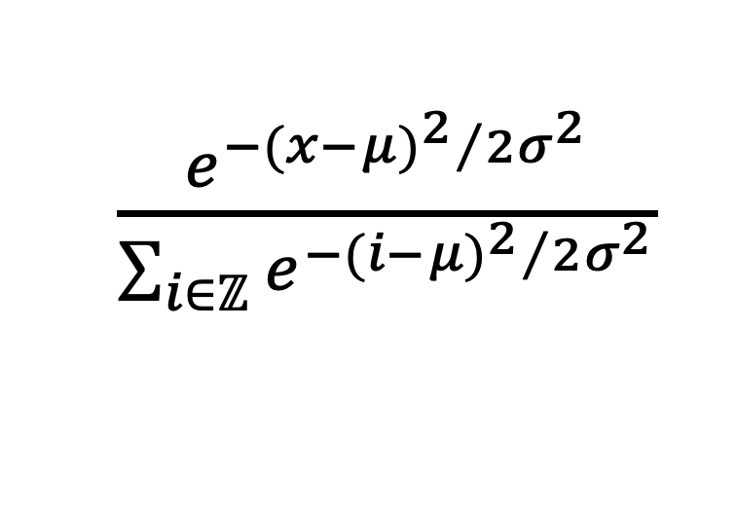
Verified Samplers
$\frac{e^{{−{(x−μ)}^{2}}/{2σ^{2}}}}{\sum_{i∈ℤ}{e^{{−{(i−μ)}^{2}}/{2σ^{2}}}}}$
Notes:
Here’s an example. We want to to sample from this mass function, called the discrete gaussian.
The discrete Gaussian was developed in the 2020’s as an alternative to continuous distributions, and they're nice for differential privacy because they're defined over the integers rather than the floating point rationals.
The formula is a little scary, it involves transcendental numbers, and big sums, division between real numbers which I know, terrifying, but bear with me.

Slide 23
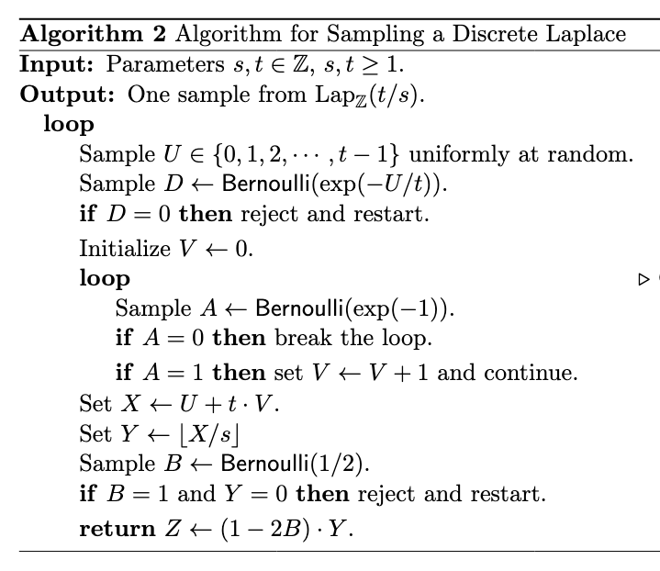
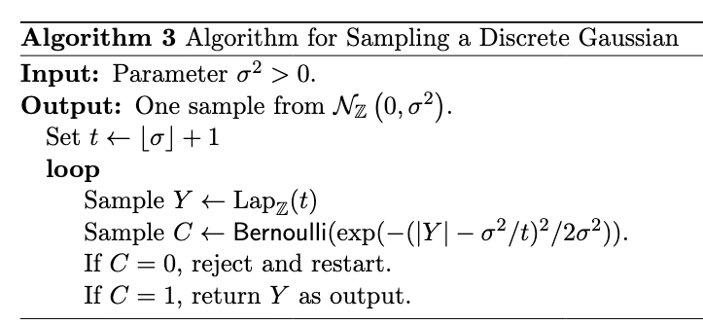
Verified Samplers
Clément L. Canonne, Gautam Kamath, and Thomas Steinke. 2020. The discrete Gaussian for differential privacy.
Notes:
We also have a very clever algorithm for sampling exactly from this distribution, described in this paper by Canonne Kamath and Steinke.
This is a small, first-order program whose which is designed to draw samples from the discrete gaussian distribution.

Slide 24
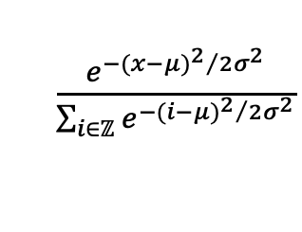
Verified Samplers
$\frac{e^{{−{(x−μ)}^{2}}/{2σ^{2}}}}{\sum_{i∈ℤ}{e^{{−{(i−μ)}^{2}}/{2σ^{2}}}}}$
Notes:
In SampCert, we translate we turn the program into a mass function by writing it in our DSL,
We turn the specification into a mass function by using that scary-looking formula,
And finally the verification challenge is to prove that the mass functions for our program and our specification are equal
And again, this is a really hard problem to deal with in general, but we can lean on the fact that we embedded ourselves inside a very rich mathematical world, and we can use the extensive amount of mechanized math in mathlib to replicate the pen and paper proof as well.

Slide 25
Verified Samplers
$\frac{e^{{−{(x−μ)}^{2}}/{2σ^{2}}}}{\sum_{i∈ℤ}{e^{{−{(i−μ)}^{2}}/{2σ^{2}}}}}$
PMF ℤ
do let Y : ℤ ← DiscreteLaplaceSampleMixed t 1 mix
let y : ℕ := Int.natAbs Y
let n : ℕ := (Int.natAbs (Int.sub (y * t * den) num))^2
let d : ℕ+ := 2 * num * t^2 * den
let C ← BernoulliExpNegSample n d
/-- continued ... -/
Notes:
In SampCert, we translate we turn the program into a mass function by writing it in our DSL,
We turn the specification into a mass function by using that scary-looking formula,
And finally the verification challenge is to prove that the mass functions for our program and our specification are equal
And again, this is a really hard problem to deal with in general, but we can lean on the fact that we embedded ourselves inside a very rich mathematical world, and we can use the extensive amount of mechanized math in mathlib to replicate the pen and paper proof as well.

Slide 26
Verified Samplers
$\frac{e^{{−{(x−μ)}^{2}}/{2σ^{2}}}}{\sum_{i∈ℤ}{e^{{−{(i−μ)}^{2}}/{2σ^{2}}}}}$
PMF ℤ
PMF ℤ
do let Y : ℤ ← DiscreteLaplaceSampleMixed t 1 mix
let y : ℕ := Int.natAbs Y
let n : ℕ := (Int.natAbs (Int.sub (y * t * den) num))^2
let d : ℕ+ := 2 * num * t^2 * den
let C ← BernoulliExpNegSample n d
/-- continued ... -/
def gauss_term_ℝ (σ μ : ℝ) (x : ℝ) : ℝ :=
Real.exp ((-(x - μ)^2) / (2 * σ^2))
def discrete_gaussian (σ μ : ℝ) x : ℝ :=
gauss_term_ℝ σ μ x / ∑' x : ℤ, gauss_term_ℝ σ μ x
Notes:
In SampCert, we translate we turn the program into a mass function by writing it in our DSL,
We turn the specification into a mass function by using that scary-looking formula,
And finally the verification challenge is to prove that the mass functions for our program and our specification are equal
And again, this is a really hard problem to deal with in general, but we can lean on the fact that we embedded ourselves inside a very rich mathematical world, and we can use the extensive amount of mechanized math in mathlib to replicate the pen and paper proof as well.

Slide 27
Verified Samplers
$\frac{e^{{−{(x−μ)}^{2}}/{2σ^{2}}}}{\sum_{i∈ℤ}{e^{{−{(i−μ)}^{2}}/{2σ^{2}}}}}$
PMF ℤ
=
PMF ℤ
do let Y : ℤ ← DiscreteLaplaceSampleMixed t 1 mix
let y : ℕ := Int.natAbs Y
let n : ℕ := (Int.natAbs (Int.sub (y * t * den) num))^2
let d : ℕ+ := 2 * num * t^2 * den
let C ← BernoulliExpNegSample n d
/-- continued ... -/
def gauss_term_ℝ (σ μ : ℝ) (x : ℝ) : ℝ :=
Real.exp ((-(x - μ)^2) / (2 * σ^2))
def discrete_gaussian (σ μ : ℝ) x : ℝ :=
gauss_term_ℝ σ μ x / ∑' x : ℤ, gauss_term_ℝ σ μ x
Notes:
In SampCert, we translate we turn the program into a mass function by writing it in our DSL,
We turn the specification into a mass function by using that scary-looking formula,
And finally the verification challenge is to prove that the mass functions for our program and our specification are equal
And again, this is a really hard problem to deal with in general, but we can lean on the fact that we embedded ourselves inside a very rich mathematical world, and we can use the extensive amount of mechanized math in mathlib to replicate the pen and paper proof as well.

Slide 28
Verified Samplers
$\frac{e^{{−{(x−μ)}^{2}}/{2σ^{2}}}}{\sum_{i∈ℤ}{e^{{−{(i−μ)}^{2}}/{2σ^{2}}}}}$
Extended
Reals
Poisson Summation Formula
Complex
Numbers
PMF ℤ
PMF ℤ
Jensen’s Inequality
Topology
Notes:
In SampCert, we translate we turn the program into a mass function by writing it in our DSL,
We turn the specification into a mass function by using that scary-looking formula,
And finally the verification challenge is to prove that the mass functions for our program and our specification are equal
And again, this is a really hard problem to deal with in general, but we can lean on the fact that we embedded ourselves inside a very rich mathematical world, and we can use the extensive amount of mechanized math in mathlib to replicate the pen and paper proof as well.

Slide 29
Verified Samplers
Program
Specification
=
PMF ℤ
PMF ℤ
Notes:
One last point about shallow embeddings, we also found the modularity of this technique to be very useful.
Once we’ve proven a program and a specification are equal, we’re able to use the program and the specification interchangeably throughout the codebase.
For one this means that we get functional modularity for free: we can rewrite a program into is specification in any host code that calls it,
It means that we can mechanize standard proofs of almost-sure termination and support using the specification, which is oftentimes substantially easier than proving it about the code.
Finally, it also means that we can freely swap between different optimizations. We actually do this, late in the development of this project we found that different Laplace sampling algorithms are faster in different ranges, but because everything is equal we were able to add dynamic switching between these algorithms for free, without having to redo any of the privacy proofs which we had developed on top of them.

Slide 30
Verified Samplers
do
let v <- program
…
do
let v <- spec
…
=
Program
Specification
=
PMF ℤ
PMF ℤ
Notes:
One last point about shallow embeddings, we also found the modularity of this technique to be very useful.
Once we’ve proven a program and a specification are equal, we’re able to use the program and the specification interchangeably throughout the codebase.
For one this means that we get functional modularity for free: we can rewrite a program into is specification in any host code that calls it,
It means that we can mechanize standard proofs of almost-sure termination and support using the specification, which is oftentimes substantially easier than proving it about the code.
Finally, it also means that we can freely swap between different optimizations. We actually do this, late in the development of this project we found that different Laplace sampling algorithms are faster in different ranges, but because everything is equal we were able to add dynamic switching between these algorithms for free, without having to redo any of the privacy proofs which we had developed on top of them.

Slide 31
Verified Samplers
do
let v <- program
…
do
let v <- spec
…
=
Program
Specification
=
PMF ℤ
PMF ℤ
- Termination (AST)
- Support
- Termination (AST)
- Support
Notes:
One last point about shallow embeddings, we also found the modularity of this technique to be very useful.
Once we’ve proven a program and a specification are equal, we’re able to use the program and the specification interchangeably throughout the codebase.
For one this means that we get functional modularity for free: we can rewrite a program into is specification in any host code that calls it,
It means that we can mechanize standard proofs of almost-sure termination and support using the specification, which is oftentimes substantially easier than proving it about the code.
Finally, it also means that we can freely swap between different optimizations. We actually do this, late in the development of this project we found that different Laplace sampling algorithms are faster in different ranges, but because everything is equal we were able to add dynamic switching between these algorithms for free, without having to redo any of the privacy proofs which we had developed on top of them.

Slide 32
Verified Samplers
do
let v <- program
…
do
let v <- spec
…
…
=
Optimized
Program
Specification
=
=
PMF ℤ
PMF ℤ
PMF ℤ
…
- Termination (AST)
- Support
- Termination (AST)
- Support
Notes:
One last point about shallow embeddings, we also found the modularity of this technique to be very useful.
Once we’ve proven a program and a specification are equal, we’re able to use the program and the specification interchangeably throughout the codebase.
For one this means that we get functional modularity for free: we can rewrite a program into is specification in any host code that calls it,
It means that we can mechanize standard proofs of almost-sure termination and support using the specification, which is oftentimes substantially easier than proving it about the code.
Finally, it also means that we can freely swap between different optimizations. We actually do this, late in the development of this project we found that different Laplace sampling algorithms are faster in different ranges, but because everything is equal we were able to add dynamic switching between these algorithms for free, without having to redo any of the privacy proofs which we had developed on top of them.

Slide 33
SampCert
Execution
Abstract DP
Verified Random Sampling
Notes:
So now we have a language for expressing and reasoning about probabilistic programs
Now we want to start talking about privacy.

Slide 34
Differential Privacy
A function is ε-dp when…
Notes:
As I alluded to before, a DP program is one that produces a randomized value from a database, so that the output is not too sensitive to the data of individual contributors.
More concretely, we say that such a program is eps-DP when, for any two databases that differ by one row, their resulting probability distributions will be “within epsilon” of each other.
Or intuitively, when epsilon is small, an attacker would need a huge number of samples to infer which distribution the program is sampling from, and therefore which database has the true values of our private data.
You may notice that there are some suspicious air quotes on the slide here, and while it is true that privacy researchers broadly speaking agree on this definition of DP there are a lot of differing opinions about what “within epsilon” means.

Slide 35
Differential Privacy
A function is ε-dp when…
Differs by one
row
≈
Notes:
As I alluded to before, a DP program is one that produces a randomized value from a database, so that the output is not too sensitive to the data of individual contributors.
More concretely, we say that such a program is eps-DP when, for any two databases that differ by one row, their resulting probability distributions will be “within epsilon” of each other.
Or intuitively, when epsilon is small, an attacker would need a huge number of samples to infer which distribution the program is sampling from, and therefore which database has the true values of our private data.
You may notice that there are some suspicious air quotes on the slide here, and while it is true that privacy researchers broadly speaking agree on this definition of DP there are a lot of differing opinions about what “within epsilon” means.

Slide 36
Differential Privacy
A function is ε-dp when…
Differs by one
row
≈
≈
“Within ε..."
Notes:
As I alluded to before, a DP program is one that produces a randomized value from a database, so that the output is not too sensitive to the data of individual contributors.
More concretely, we say that such a program is eps-DP when, for any two databases that differ by one row, their resulting probability distributions will be “within epsilon” of each other.
Or intuitively, when epsilon is small, an attacker would need a huge number of samples to infer which distribution the program is sampling from, and therefore which database has the true values of our private data.
You may notice that there are some suspicious air quotes on the slide here, and while it is true that privacy researchers broadly speaking agree on this definition of DP there are a lot of variants for what “within epsilon” might mean.

Slide 37

Differential Privacy
Approximate DP
Zero-concentrated DP
Pure DP
Renyi DP
Approximate zCDP
Approximate CDP
Mean-concentrated DP
Concentrated DP
Notes:
Here’s a selection of them.
It seems like a lot, but don’t worry, they are actually way more,
They all provide slightly different privacy guarantees, slightly different composition theorems, lots of different lossy conversion bounds between them
Now despite this mess, we noticed that at a high-level is a common collection of features between a number of these definitions which differential privacy programs tend rely on.
[Flip] In SampCert, we collected these features together into an interface which we call abstract differential privacy.

Slide 38
Abstract Differential Privacy
1. Privacy definition
ε-dp ( ) : Prop
2. Composition rules
bind
(ε₁-dp A), (∀a, ε₂-dp B a) => (ε₁+ε₂)-dp (bind A B)
apply
(ε-dp A) => ε-dp (apply f A)
const
0-dp (const x)
3. Noise rule
Notes:
In SampCert, we collected these features together into an interface which we call abstract differential privacy.
This interface has three parts.
For one, it parameterizes by a proposition of one real-valued parameter, which defines a measurement of privacy for a noisy query over a database.
Next, our interface requires that this proposition obey a limited selection of composition rules,
In particular,
Applying two queries in sequence has to add their privacy bounds,
Applying a pure function to a private query, also known as postprocessing, can’t increase the privacy bound,
And that constant functions are perfectly private,
And finally, we require some way to make numerical statistics private by adding random noise.

Slide 39
Abstract Differential Privacy
1. Privacy definition
ε-dp ( ) : Prop
2. Composition rules
bind
(ε₁-dp A), (∀a, ε₂-dp B a) => (ε₁+ε₂)-dp (bind A B)
apply
(ε-dp A) => ε-dp (apply f A)
const
0-dp (const x)
3. Noise rule
Notes:
In SampCert, we collected these features together into an interface which we call abstract differential privacy.
This interface has three parts.
For one, it parameterizes by a proposition of one real-valued parameter, which defines a measurement of privacy for a noisy query over a database.
Next, our interface requires that this proposition obey a limited selection of composition rules,
In particular,
Applying two queries in sequence has to add their privacy bounds,
Applying a pure function to a private query, also known as postprocessing, can’t increase the privacy bound,
And that constant functions are perfectly private,
And finally, we require some way to make numerical statistics private by adding random noise.

Slide 40
Abstract Differential Privacy
1. Privacy definition
ε-dp ( ) : Prop
2. Composition rules
bind
(ε₁-dp A), (∀a, ε₂-dp B a) => (ε₁+ε₂)-dp (bind A B)
apply
(ε-dp A) => ε-dp (apply f A)
const
0-dp (const x)
3. Noise rule
Notes:
In SampCert, we collected these features together into an interface which we call abstract differential privacy.
This interface has three parts.
For one, it parameterizes by a proposition of one real-valued parameter, which defines a measurement of privacy for a noisy query over a database.
Next, our interface requires that this proposition obey a limited selection of composition rules,
In particular,
Applying two queries in sequence has to add their privacy bounds,
Applying a pure function to a private query, also known as postprocessing, can’t increase the privacy bound,
And that constant functions are perfectly private,
And finally, we require some way to make numerical statistics private by adding random noise.

Slide 41
Abstract Differential Privacy
3. Noise rule
Bounded sensitivity:
f :
Int
D₁ ≈ D₂ 🡒 | f D₁ – f D₂| < d
Then we can add noise such that
ε-dp ( f + )
noise
Notes:
We require that for any integer-valued query over a database with an upper bound on how sensitive the function is to changing individual rows in the dabase,
There exists a noise distribution such that our query plus that noise is epsilon-dp

Slide 42
Pure DP
Abstract Differential Privacy
- Pointwise PMF bound
Abstract DP
1. Privacy definition
2. Composition rules
Zero-Concentrated DP
3. Noise rule
- Information bound
Notes:
In SampCert, we've instansiated that interface with two of the variants of DP that we care about at AWS
That is Pure DP with noise drawn from a discrete Laplace operator and zero-concentrated DP with noise drawn from the discrete gaussian.
There are other variants such as Renyi DP which fit into this framework but we have yet to mechanize.
The proofs that these DP systems satisfy the bounds are quite involved, in particular zero-concentrated differential pricay for example involved Fourier analsysi and and a version of Jensen’s inequality that uses extended real numbers, but using mathlib allowed us to mechanize all of these arguments based on what we read on papers .

Slide 43
Abstract Differential Privacy
count
def privHistogram (D : Database) (n : ℕ) :=
match n with
| 0 => const (emptyHistogram)
| n.succ =>
bind (privHistogram D (n-1)) $
bind (count D n + noise eps) $
apply (updateHistogram D n v)
1
2
3
4
5
6
7
Notes:
To round off this section I’ll show you what this interface can do.
On the slide I have a program which builds a histogram from your data, and makes it private by adding noise to the count in each bin.
I don’t have time to get into the proof itself but in this case you can verify a DP bound on this program by following your nose and applying whichever rule from the interface matches at each step
And you end up with an abstract privacy bound which applies no matter which instance of abstract DP you use!
I can speak more about the pros and cons of this approach afterwards—I will say that despite the fact that this is not a universal proof technique, we found that just using the interface alone was still quite versatile.

Slide 44
Abstract Differential Privacy
count
def privHistogram (D : Database) (n : ℕ) :=
match n with
| 0 => const (emptyHistogram)
| n.succ =>
bind (privHistogram D (n-1)) $
bind (count D n + noise eps) $
apply (updateHistogram D n v)
const
noise
bind
bind
apply
1
2
3
4
5
6
7
Notes:
To round off this section I’ll show you what this interface can do.
On the slide I have a program which builds a histogram from your data, and makes it private by adding noise to the count in each bin.
I don’t have time to get into the proof itself but in this case you can verify a DP bound on this program by following your nose and applying whichever rule from the interface matches at each step
And you end up with an abstract privacy bound which applies no matter which instance of abstract DP you use!
I can speak more about the pros and cons of this approach afterwards—I will say that despite the fact that this is not a universal proof technique, we found that just using the interface alone was still quite versatile.

Slide 45
Abstract Differential Privacy
count
def privHistogram (D : Database) (n : ℕ) :=
match n with
| 0 => const (emptyHistogram)
| n.succ =>
bind (privHistogram D (n-1)) $
bind (count D n + noise eps) $
apply (updateHistogram D n v)
const
noise
bind
bind
apply
1
2
3
4
5
6
7
⇒ Generic Privacy Bound
Notes:
To round off this section I’ll show you what this interface can do.
On the slide I have a program which builds a histogram from your data, and makes it private by adding noise to the count in each bin.
I don’t have time to get into the proof itself but in this case you can verify a DP bound on this program by following your nose and applying whichever rule from the interface matches at each step
And you end up with an abstract privacy bound which applies no matter which instance of abstract DP you use!
I can speak more about the pros and cons of this approach afterwards—I will say that despite the fact that this is not a universal proof technique, we found that just using the interface alone was still quite versatile.

Slide 46
SampCert
Execution
Abstract DP
Verified Random Sampling
Notes:
Okay now we have a theory of DP in Lean
We want to get it ready to deploy out in the world.

Slide 47
Execution
T → ℝ
Noncomputable
Notes:
You’ll recall that we’ve shallowly embedded our programs shallowly into the type of mass functions, which the Lean compiler in general does not know know to compile never mind compile to a probabilistic program.
FLIP
However, our programs were also not just arbitrary mass functions, you’ll also remember that we decided to write them inside a little DSL,
And so that carves out a subset of mass functions which are distinguished by the characteristic that they do have a known sampling algorithm.

Slide 48
Execution
T → ℝ
Noncomputable
DSL
Has sampling algorithm
Notes:
You’ll recall that we’ve shallowly embedded our programs shallowly into the type of mass functions, which the Lean compiler in general does not know know to compile never mind compile to a probabilistic program.
FLIP
However, our programs were also not just arbitrary mass functions, you’ll also remember that we decided to write them inside a little DSL,
And so that carves out a subset of mass functions which are distinguished by the characteristic that they do have a known sampling algorithm.

Slide 49
Execution
return
uniformByte
2⁸
bind
while
Notes:
The four terms in our DSL were chosen not just because there were straightforward to reason about mathematically, but also because they tightly correspond to terms of a imperative language.
In SampCert we use the Lean foreign function interface to attach a C++ implementation for these terms, and this allows Lean to compile our samplers into genuine executable randomized programs.
Even once you add in the Lean boilerplate, this amounts to adding around 50 lines of trusted C++ code, which mostly amounts to ensuring you apply the right functions to each other in the right order, and which is well-within what we would consider acceptable from a security standpoint.

Slide 50
Execution
return
uniformByte
unsigned char r;
read(urandom, &r,1);
return r;
return v;
bind
while
lean_object * state = init;
uint8_t cond = lean_apply_1(condition,state);
while (cond) {
state = lean_apply_2(body,state);
cond = lean_apply_1(condition,state); }
return state;
lean_object * exf = lean_apply_1(f);
lean_object * pa = lean_apply_2(g,exf);
return pa;
Notes:
The four terms in our DSL were chosen not just because there were straightforward to reason about mathematically, but also because they tightly correspond to terms of a imperative language.
In SampCert we use the Lean foreign function interface to attach a C++ implementation for these terms, and this allows Lean to compile our samplers into genuine executable randomized programs.
Even once you add in the Lean boilerplate, this amounts to adding around 50 lines of trusted C++ code, which mostly amounts to ensuring you apply the right functions to each other in the right order, and which is well-within what we would consider acceptable from a security standpoint.

Slide 51
Execution
SampCert
Notes:
What does this 50 lines get us? I asked you at the beginning to imagine you were a statistician so hopefully you’ll enjoy a good graph.
Here is the performance of our discrete gaussian sampler compared against some publicly available implementations.
Our extracted code has performance which is competitive with publicly available DP libraries, is substantially more robust because it is derived from a verified implementation.
This code is currently in use at AWS.

Slide 52
SampCert
Execution
Foundational verification
Versatile and generic proofs
Competitive performance
Deployed at AWS
Abstract DP
Verified Random Sampling
Notes:
Okay, that’s my time, thank you for your attention and I’m very happy to take any questions!

